Slide 1

Week 4: List ADT
CS/COE 0445 - Data Structures
Sherif Khattab
http://www.cs.pitt.edu/~skhattab/cs0445
(Some slide contents are © 2016 Pearson Education, Ltd. All rights reserved.
Others are from Dr. Ramirez’s CS 445 course)

Slide 2
Administrivia
Assignment 1 late submission due on Wednesday Jan. 31 @11:59pm
Assignment 2 out this Friday
Quiz 1 in recitations of this week
Open book, notes, and Internet
Design and implement a small program
Check the post-lab follow-up questions!

Slide 3
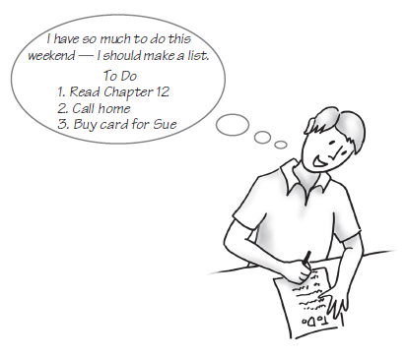
Lists
FIGURE 12-1 A to-do list

Slide 4
Specifications for the ADT List
add (newEntry)
add (newPosition, newEntry)
remove(givenPosition)
clear()
replace( givenPosition, newEntry)
getEntry( givenPosition)
toArray()
contains(anEntry)
getLength()
isEmpty()

Slide 5
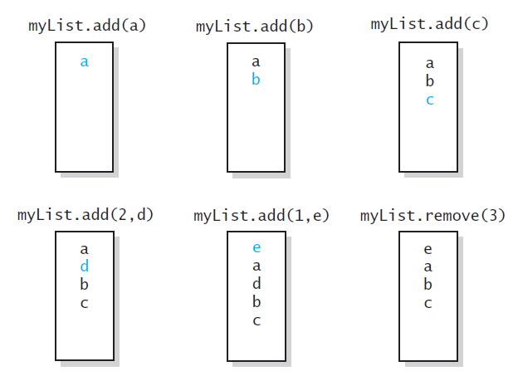
Specifications for the ADT List
FIGURE 12-2 The effect of ADT list operations on an initially empty list

Slide 6
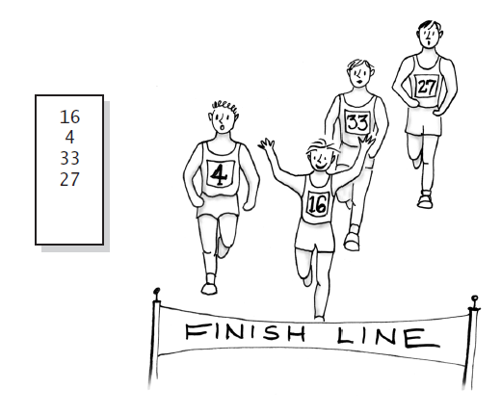
Using the ADT List
FIGURE 12-3 A list of numbers that identify runners in the order in which they finished a race

Slide 7
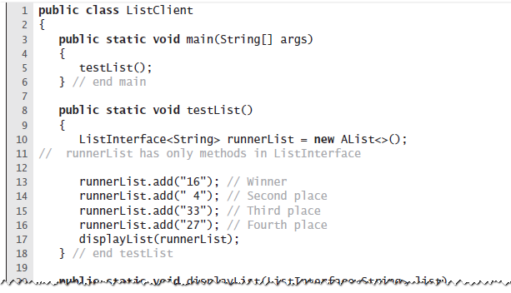
Using the ADT List
LISTING 12-2 A client of a class that implements ListInterface

Slide 8
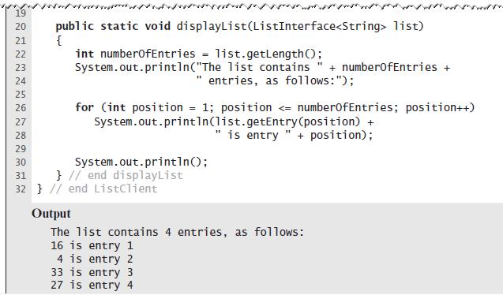
Using the ADT List
LISTING 12-2 A client of a class that implements ListInterface

Slide 9
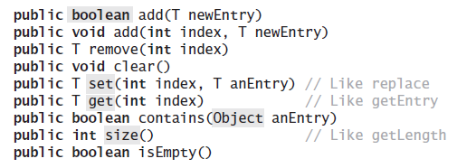
Java Class Library:The Interface List
Method headers from the interface List

Slide 10
Java Class Library: The Class ArrayList
Available constructors
public ArrayList()
public ArrayList(int initialCapacity)
Similar to java.util.vector
Can use either ArrayList or Vector as an implementation of the interface List.

Slide 11
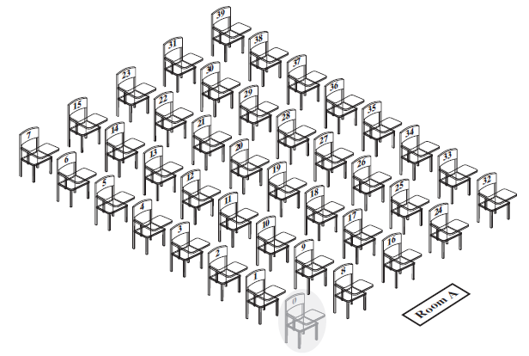
Array to Implement the ADT List
FIGURE 13-1 A classroom that contains desks in fixed positions

Slide 12
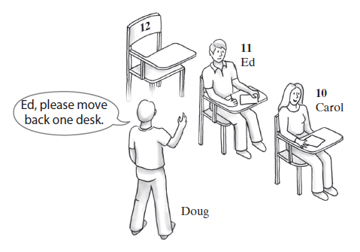
Array to Implement the ADT List
FIGURE 13-2 Seating a new student between two existing students: At least one other student must move

Slide 13
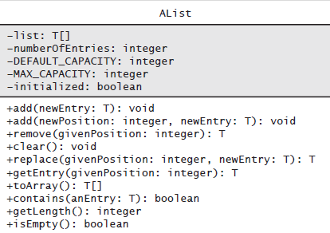
Array to Implement the ADT List
FIGURE 13-3 UML notation for the class AList

Slide 14
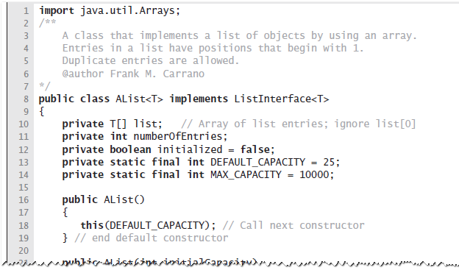
Array to Implement the ADT List
LISTING 13-1 The class AList

Slide 15
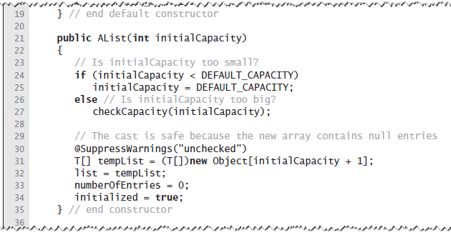
Array to Implement the ADT List
LISTING 13-1 The class AList

Slide 16
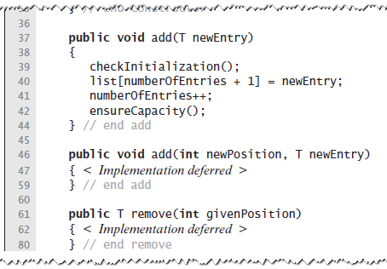
Array to Implement the ADT List
LISTING 13-1 The class AList

Slide 17
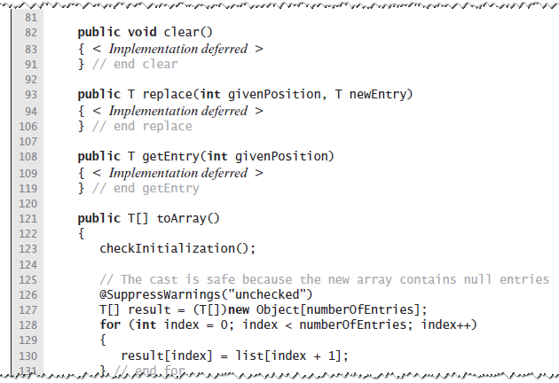
Array to Implement the ADT List
LISTING 13-1 The class AList

Slide 18
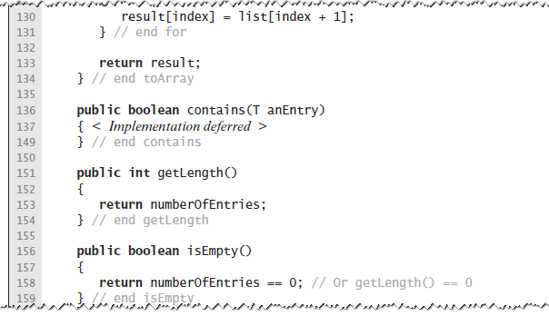
Array to Implement the ADT List
LISTING 13-1 The class AList

Slide 19
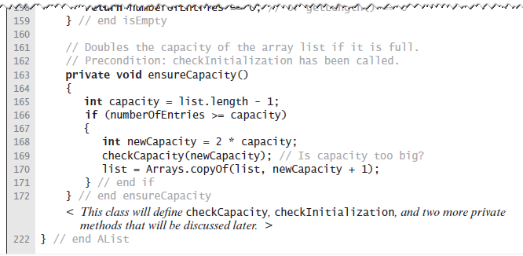
Array to Implement the ADT List
LISTING 13-1 The class AList

Slide 20
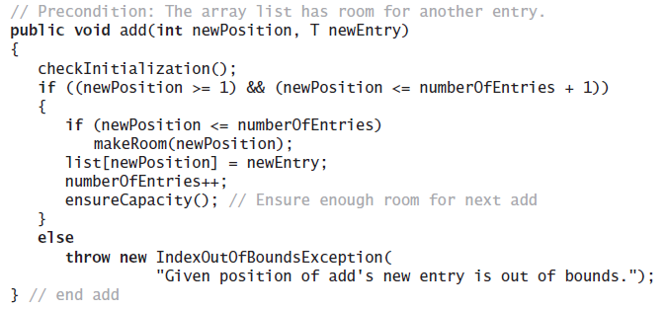
Array to Implement the ADT List
Implementation of add uses a private method makeRoom to handle the details of moving data within the array

Slide 21
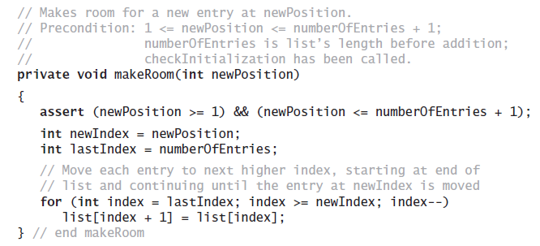
Array to Implement the ADT List
Implement the private method makeRoom

Slide 22
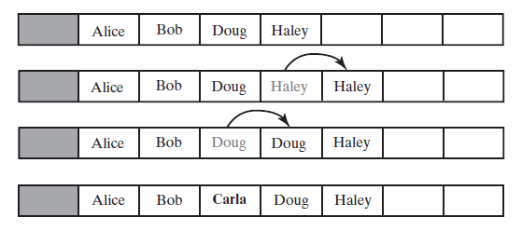
Array to Implement the ADT List
FIGURE 13-4 Making room to insert Carla as the third entry in an array

Slide 23
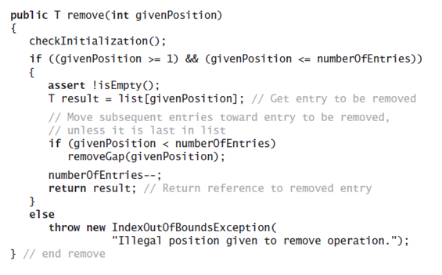
Array to Implement the ADT List
Implementation uses a private method removeGap to handle the details of moving data within the array.

Slide 24
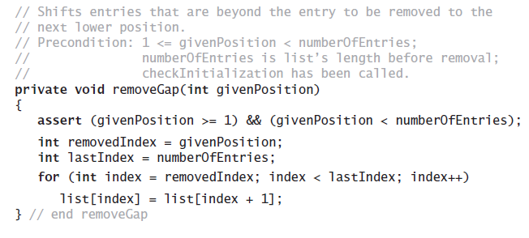
Array to Implement the ADT List
Method removeGap shifts list entries within the array

Slide 25
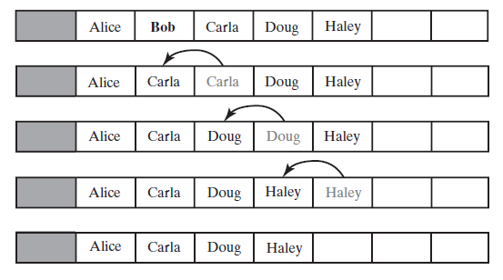
Array to Implement the ADT List
FIGURE 13-5 Removing Bob by shifting array entries

Slide 26
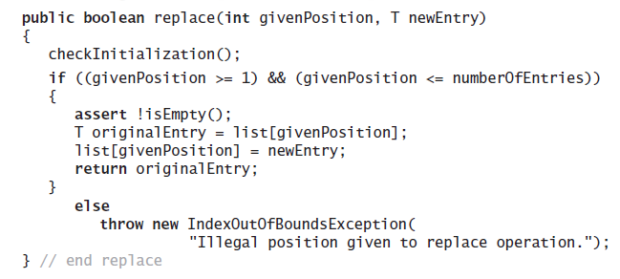
Array to Implement the ADT List
Method replace

Slide 27
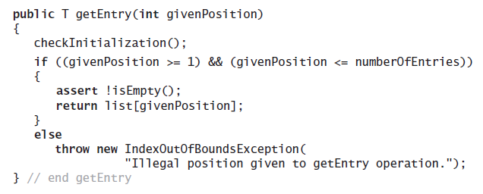
Array to Implement the ADT List
Method getEntry

Slide 28
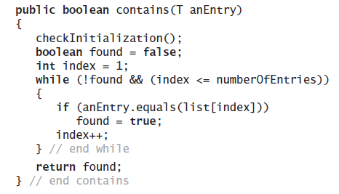
Array to Implement the ADT List
Method contains uses a local boolean variable to terminate the loop when we find the desired entry.

Slide 29
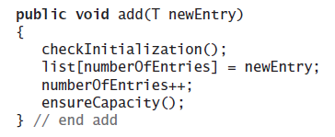
Array to Implement the ADT List
Operation that adds a new entry to the end of a list.
Efficiency O(1) if new if array is not resized.

Slide 30
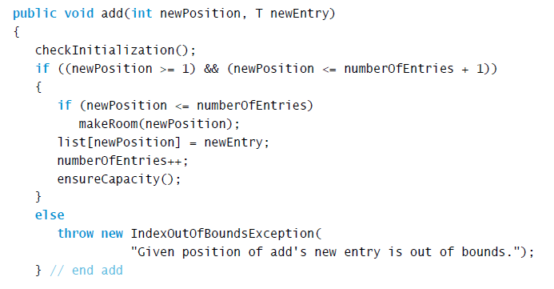
Array to Implement the ADT List
Add a new entry to a list at a client-specified position.

Slide 31
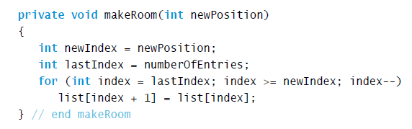
Array to Implement the ADT List
Method add uses method makeRoom.

Slide 32
Linked Implementation
Uses memory only as needed
When entry removed, unneeded memory returned to system
Avoids moving data when adding or removing entries

Slide 33
Linked Implementation
Uses memory only as needed
When entry removed, unneeded memory returned to system
Avoids moving data when adding or removing entries

Slide 34
Adding a Node at Various Positions
Possible cases:
Chain is empty
Adding node at chain’s beginning
Adding node between adjacent nodes
Adding node to chain’s end

Slide 35

Adding a Node to an empty chain
This pseudocode establishes a new node for the given data

Slide 36
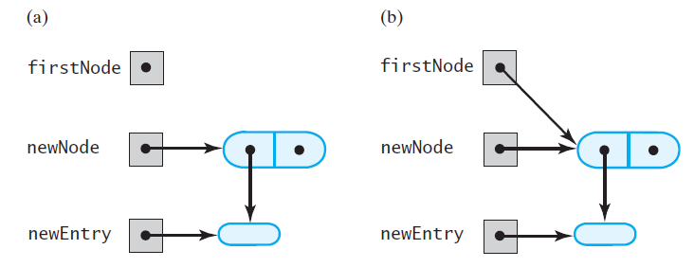
Adding a Node
FIGURE 14-1 (a) An empty chain and a new node; (b) after adding the new node to a chain that was empty

Slide 37

Adding a Node
This pseudocode describes the steps needed to add a node to the beginning of a chain.

Slide 38
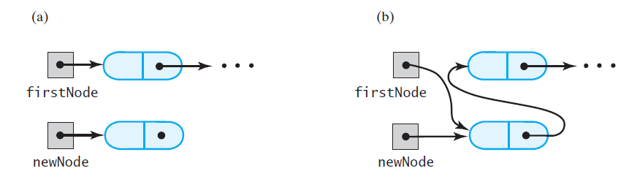
Adding a Node
FIGURE 14-2 A chain of nodes (a) just prior to adding a node at the beginning; (b) just after adding a node at the beginning

Slide 39
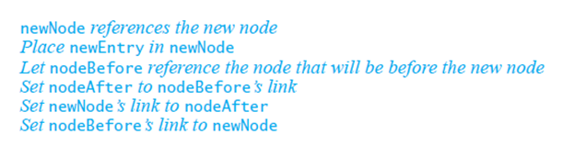
Adding a Node
Pseudocode to add a node to a chain between two existing, consecutive nodes

Slide 40
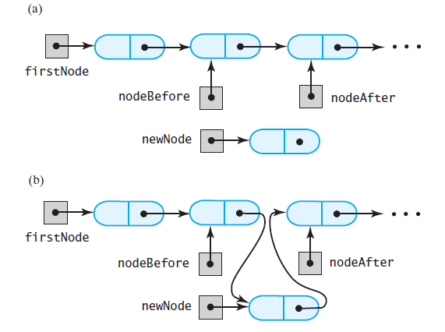
Adding a Node
FIGURE 14-3 A chain of nodes (a) just prior to adding a node between two adjacent nodes; (b) just after adding a node between two adjacent nodes

Slide 41
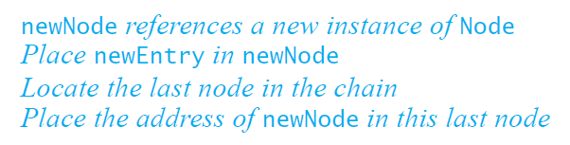
Adding a Node
Steps to add a node at the end of a chain.

Slide 42
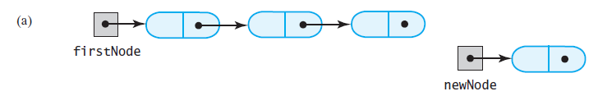
Adding a Node
FIGURE 14-4 A chain of nodes (a) prior to adding a node at the end

Slide 43
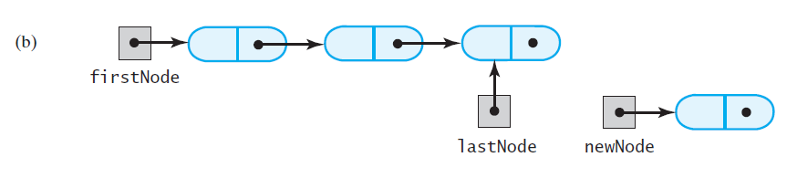
Adding a Node
FIGURE 14-4 A chain of nodes (b) after locating its last node;

Slide 44
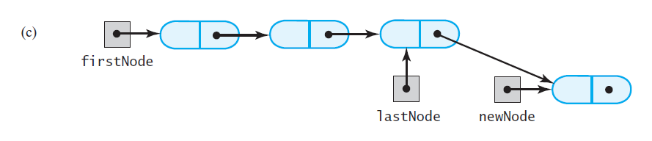
Adding a Node
FIGURE 14-4 A chain of nodes (c) after adding a node at the end

Slide 45
Removing a Node from Various Positions
Possible cases
Removing the first node
Removing a node other than first one

Slide 46
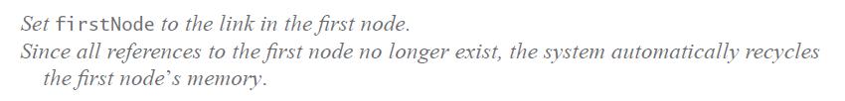
Removing a Node
Steps for removing the first node.

Slide 47
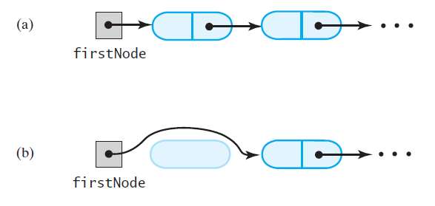
Removing a Node
FIGURE 14-5 A chain of nodes (a) just prior to removing the first node; (b) just after removing the first node

Slide 48
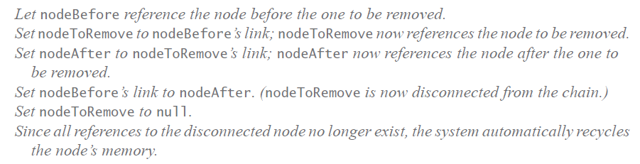
Removing a Node
Removing a node other than the first one.

Slide 49
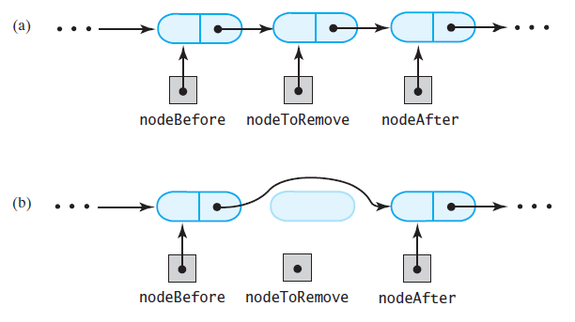
Removing a Node
FIGURE 14-6 A chain of nodes (a) just prior to removing an interior node; (b) just after removing an interior node

Slide 50
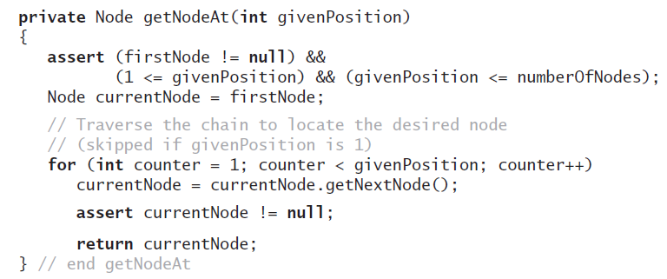
Removing a Node
Operations on a chain depended on the method getNodeAt

Slide 51
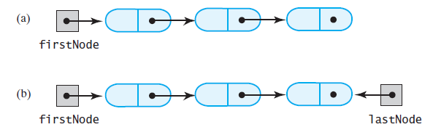
Design Decision: A Link to Last Node
FIGURE 14-7 A linked chain with (a) a head reference; (b) both a head reference and a tail reference

Slide 52
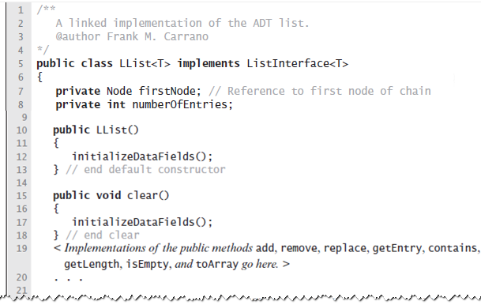
Data Fields and Constructor
LISTING 14-1 An outline of the class LList

Slide 53
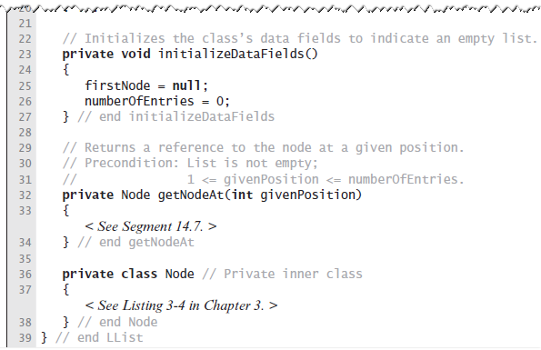
Data Fields and Constructor
LISTING 14-1 An outline of the class LList

Slide 54
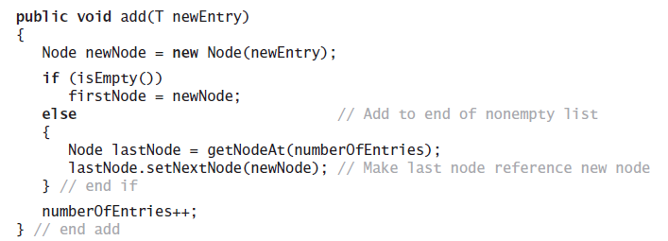
Adding to the End of the List
The method add assumes method getNodeAt

Slide 55
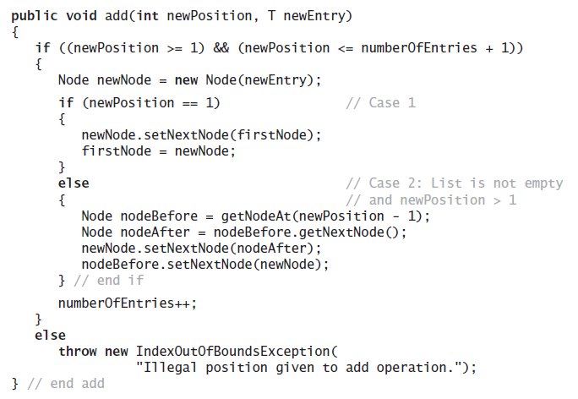
Adding at a Given Position
Java method.

Slide 56
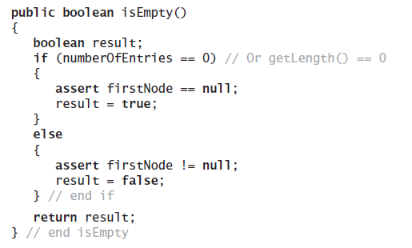
Method isEmpty
Note use of assert statement.

Slide 57
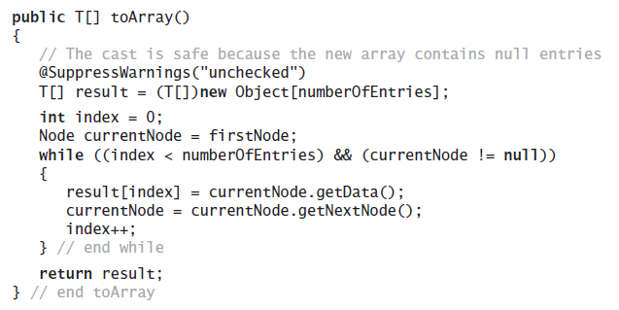
Method toArray
Traverses chain, loads an array.

Slide 58
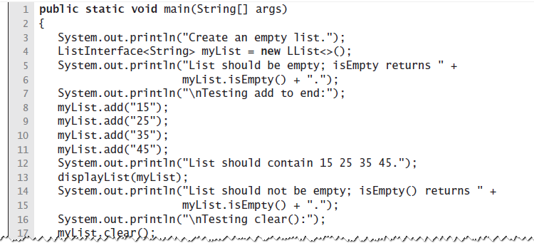
Testing Core Methods
LISTING 14-2 A main method that tests part of the implementation of the ADT list

Slide 59
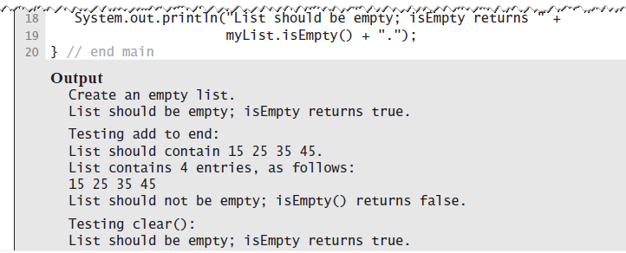
Testing Core Methods
LISTING 14-2 A main method that tests part of the implementation of the ADT list

Slide 60
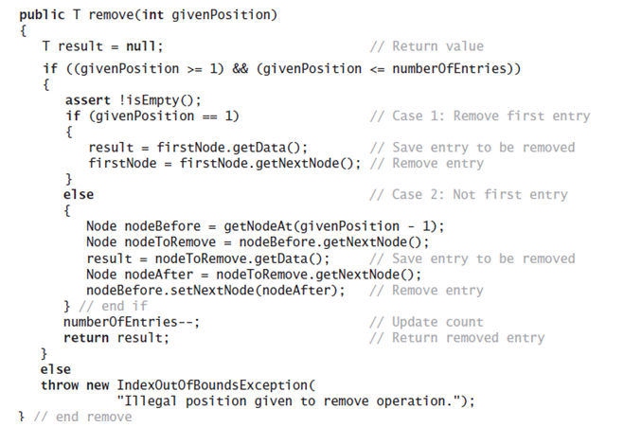
Continuing the Implementation
The remove method returns the entry that it deletes from the list

Slide 61

Continuing the Implementation
Replacing a list entry requires us to replace the data portion of a node with other data.

Slide 62

Continuing the Implementation
Retrieving a list entry is straightforward.

Slide 63

Continuing the Implementation
Checking to see if an entry is in the list, the method contains.

Slide 64

A Refined Implementation
FIGURE 14-8 A linked chain with both a head reference and a tail reference

Slide 65

A Refined Implementation
FIGURE 14-9 Adding a node to the end of a nonempty chain that has a tail reference

Slide 66

A Refined Implementation
Revision of the first add method

Slide 67

A Refined Implementation
Implementation of the method that adds by position.

Slide 68

A Refined Implementation
Implementation of the method that adds by position.

Slide 69

A Refined Implementation
FIGURE 14-10 Removing the last node from a chain that has both head and tail references when the chain contains (a) one node

Slide 70

A Refined Implementation
FIGURE 14-10 Removing the last node from a chain that has both head and tail references when the chain contains (b) more than one node

Slide 71

A Refined Implementation
Implementation of the remove operation:

Slide 72

A Refined Implementation
Implementation of the remove operation:

Slide 73

Efficiency of Using a Chain
FIGURE 14-11 The time efficiencies of the ADT list operations for three implementations, expressed in Big Oh notation

Slide 74
Java Class Library:The Class LinkedList
Implements the interface List
LinkedList defines more methods than are in the interface List
You can use the class LinkedList as implementation of ADT
queue
deque
or list.

